Slide 1

DAT-475
Project 3
Don Zeller
6/17/24
Notes:
No speaker notes on this slide.

Slide 2
Manufacturing Process Improvement Analysis
Addressing Defects in the Welding Process
Notes:
Good morning everyone. I’m Don Zeller, and today I'll be presenting our analysis on improving our manufacturing process by addressing defects in the welding process of our electronic boards.
This analysis is important for maintaining product quality, compliance with standards, enhancing customer satisfaction, and optimizing operational costs.

Slide 3
01
Problem
Statement
Notes:
No Speaker notes on this slide.

Slide 4
Objectives
The Problem
The Goal
Our organization is experiencing a significant increase in defects during the welding process of electronic boards, specifically related to Thru-Holes components.
The goal is to reduce these defects by 20% while simultaneously increasing production capacity by 20%.
Notes:
Our objective will be to review the analysis we performed to address the defect issues in our manufacturing process. The primary goal is to reduce defects by 20% while increasing production capacity by the same percentage without raising the defect rate. Welding defects, such as solder bridges, excessive solder, lifted components, and missing components, are adversely impacting our product quality, compliance with IPC-A-610E standards, customer satisfaction, and operational efficiency.
It is imperative that we identify the root causes and implement effective solutions to mitigate these issues promptly.

Slide 5
02
Initial
Analysis
Pareto Charts
Notes:
Our initial analysis utilized Pareto charts to identify the most significant defects across the entire facility and for specific models (595407-XXX-00, 595481-00X-00, 595310-001-00). Pareto charts display the frequency of values sorted by different levels of a categorical variable. These charts illustrate the "80/20" rule, which suggests that roughly 80% of problems stem from 20% of the causes (JMP, n.d.).

Slide 6
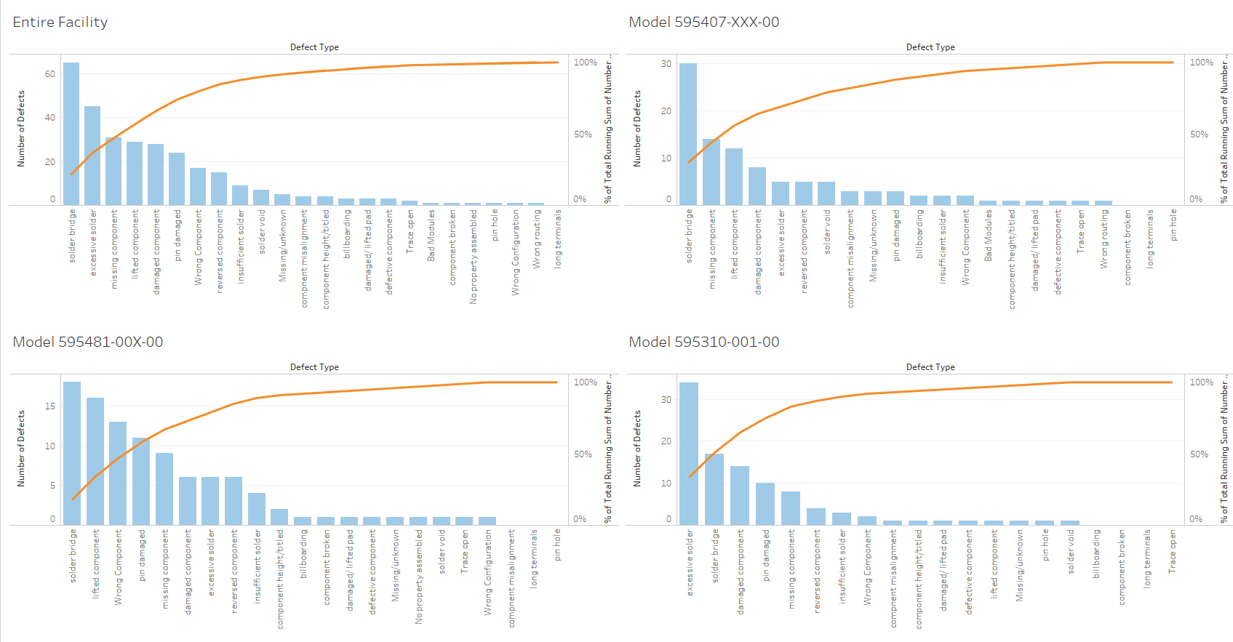
Notes:
With the use of pareto analysis, we were able to identify the root cause of the defects. We conducted the analysis on the entire facility as well as each individual model’s assembly line to find out which defect types were most prevalent. The defect types seen in the charts represent the primary issues affecting the quality of the electronic boards during the welding process. Contributing to over 60% of the total defects, solder bridge and excessive solder defects indicate critical areas that need attention. Lifted components and missing components are also significant contributors to the overall defect count. Addressing these key issues will significantly improve our defect rates.

Slide 7
03
Formulating a Hypothesis
Notes:
Our next approach was to conduct hypothesis testing. Hypothesis testing (as you may know) is a statistical method that allows us to evaluate the reliability of our findings. By formulating a clear hypothesis and conducting appropriate statistical tests, we can draw meaningful conclusions about the defect rates in our production lines and determine if the observed differences are statistically significant (Majasaki, 2024.).

Slide 8
Formulating a Hypothesis
Purpose: Determine if there is a statistically significant difference in defect percentages among our three production lines.
Importance: Helps identify which production line requires corrective measures to reduce defects and improve overall quality.
Notes:
In our initial analysis, we identified root causes of our problem by examining both the entire facility and individual production lines. During the analysis, defects were discovered within specific production lines. Our next step consisted of conducting a hypothesis test to determine if there is a statistically significant difference in the defect percentages among the three production lines. The test will help us identify if the production line with the highest defect percentage is significantly different from the others, thereby justifying the need for corrective actions on that line.

Slide 9
Hypothesis Statements
Null Hypothesis
Null Hypothesis (H0): The mean percentage of defects is the same across all three production lines (μ1 = μ2 = μ3).
Alternative Hypothesis
Alternative Hypothesis (H1): At least one production line has a different mean percentage of defects (at least one μ ≠ μj for i ≠ j).
Significance Level
Significance Level: Chosen α (alpha) Level 0.05
Notes:
Before we conducted any actual testing, we first had to outline our hypothesis statements to guide our analysis. The null hypothesis assumes that all production lines have the same defect rate, indicating no significant differences. The alternative hypothesis suggests that at least one production line has a different defect rate, which indicates a significant difference in performance. We then set a significance level of 0.05, this signifies a 5% chance of rejecting the null hypothesis when it is actually true, which is a standard risk level in statistical testing (e (Laerd Statistics, n.d.).

Slide 10
04
Testing the Hypothesis
ANOVA Test
Notes:
After we formulated our hypothesis, we were then ready to test it. We collected actual production data from our three lines in order to provide the evidence necessary for our analysis. We then performed a One-Way ANOVA. This test is ideal for comparing the means of three or more groups to determine if there is a difference among them, ANOVA evaluates the null hypothesis that all group means are equal against the alternative hypothesis that at least one group mean is different (Statistics Solutions, 2024). Since we needed to compare defect percentages across three production lines, ANOVA was the appropriate method to identify any statistically significant differences in defect rates between the groups.

Slide 11
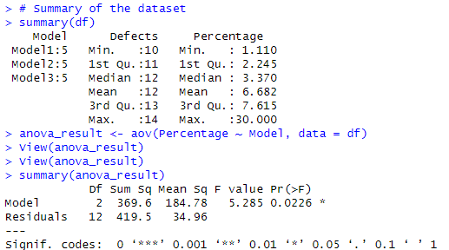
ANOVA Test
Notes:
This slide shows the results of the One-Way ANOVA test we used to compare defect percentages across the three production lines. As previously mentioned, the goal of the ANOVA test is to see if there are significant differences in defect rates between the lines.
In the output above, we focus on two key values: the F-statistic (circled in blue) and the p-value (circled in red). The F-statistic tells us how much the defect rates vary between the production lines compared to within each line. A higher F-statistic means bigger differences between the lines. The p-value, helps us decide if these differences are statistically significant. Since the p-value is less than 0.05, we reject the null hypothesis. This means there are significant differences in defect rates among the production lines, which helps us know where to focus our quality improvement efforts.

Slide 12
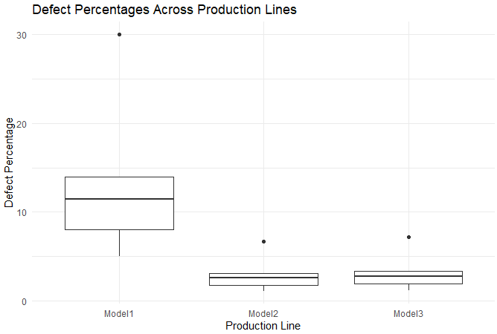
Boxplot
Notes:
To provide a visual representation of the analyzed production data and to make it easier to understand differences in defect percentages, we created a boxplot. This Boxplot shows the distribution, central
tendency, and variability of the data across the three production lines (Atlassian, n.d.). In this visualization, we can see that Model1 has a significantly higher defect percentage over Model2 and Model3.

Slide 13
05
Summary of Results
Notes:
No speaker notes on this slide.

Slide 14
Key Findings
Production Defect Percentage by Production Line
Primary Defects
Solder Bridges
Excessive Solder
Lifted Components
Missing Components
Model 1 13.7%
Model 2 3.046%
Model 3 3.3%
Notes:
In summary, our Pareto analysis pinpointed issues with solder bridges and excessive solder as the predominant causes of defects, responsible for a majority of the issues observed. These findings indicate systemic challenges in soldering processes across all assembly lines. Lifted components and missing components are also significant contributors, pointing to potential issues in component handling and placement. While pin damage and damaged components contribute to a smaller proportion of defects, they still warrant attention due to their impact on overall product quality. Addressing these key areas will be necessary to improve manufacturing quality and minimize defects across the entire facility.
Regarding our hypothesis test results, we found a significant difference in defect percentages among the three production lines. The p-value of 0.0226, which is less than the significance level of 0.05, led us to reject the null hypothesis. This indicates that the mean defect percentages vary significantly across the production lines: Model1 has the highest at 13.7%, while Model2 and Model3 have 3.046% and 3.3%, respectively.
These findings can help us begin targeted interventions, particularly on the production line for Model1, to improve its defect rates. We can also expand our investigation into the root causes of manufacturing defects related to solder and component issues, as they are the prominent defect issues across the entire facility. By utilizing these findings and implementing targeted solutions, we can reduce defects and improve overall product quality for our organization.

Slide 15
Thanks!
Questions and Answers
Notes:
Thank you for your attention. At this stage, I welcome any questions or feedback you may have regarding our analysis and findings. We've identified key areas for improvement in our manufacturing processes, particularly focusing on addressing soldering and component issues to enhance product quality and reduce defects. Our next steps involve implementing targeted measures, particularly on the production line for Model1, where defect rates are highest. I'm open to discussing our approach, the statistical methods used, or any specific recommendations you may need. Let's open the floor to your questions.

Slide 16
References
JMP. Pareto Chart. (n.d.). Introduction to Statistics | JMP. https://www.jmp.com/en_us/statistics-knowledge-portal/exploratory-data-analysis/pareto-chart.html
Majaski, C. (2024, May 3). Hypothesis Testing: 4 Steps and Example. Investopedia. https://www.investopedia.com/terms/h/hypothesistesting.asp#:~:text=Hypothesis%20testing%20refers%20to%20a,based%20on%20the%20data%20presented
SNHU, (n.d.). DAT 475 Project Case Study. Retrieved from
https://learn.snhu.edu/content/enforced/1610937-DAT-475-12625.202451-1/course_documents/DAT%20475%20Project%20Case%20Study.pdf?ou=1610937
Laerd Statistics. Hypothesis Testing - Significance levels and rejecting or accepting the null
hypothesis. (n.d.). https://statistics.laerd.com/statistical-guides/hypothesis-testing-3.php
Statistics Solutions. Understanding ANOVA: Analyzing Variance in Multiple Groups. (2024,
April 17). Statistics Solutions. https://www.statisticssolutions.com/free-resources/directory-of-statistical-analyses/anova/
A Complete Guide to Box Plots | Atlassian. (n.d.). Atlassian.
https://www.atlassian.com/data/charts/box-plot-complete-guide
Notes:
No speaker notes on this slide.

